Slide 1
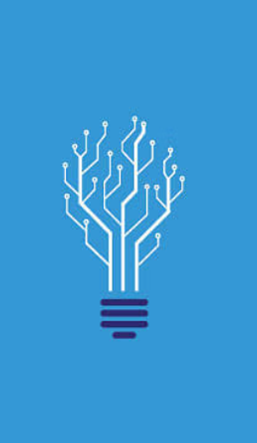
Future’s Technology Trend
MAYUR SHARMA
2nd October, 2023

Slide 2




OUTLINE
Executive Summary
Introduction
Methodology
Results
Visualization – Charts
Dashboard
Discussion
Findings & Implications
Conclusion
Appendix
Job Posting and Popular Language Bar-Chart

Slide 3
EXECUTIVE SUMMARY
Based on the observations gathered from respondents' preferences in both the present and future scenarios, several key trends and patterns have emerged within the realm of programming languages, databases, web frameworks, and platforms. The respondents' demographic information also provides valuable insights into their background and location.
Present Preferences:
Programming Languages: JavaScript and HTML are the dominant programming languages among respondents, indicating their widespread usage.
Database Choices: SQL is the most favored database system, with Microsoft SQL being recognized as the most reliable choice, particularly for major platforms.
Platform Preferences: Windows is the preferred platform for those working with C#, HTML, and JavaScript in .Net and JQuery web frameworks. Linux is also highly regarded, given its versatility across various languages, databases, and web frameworks.

Slide 4
Future Preferences:
Programming Languages: Respondents anticipate the continued popularity of JavaScript and HTML in the future. Python, Typescript, and C# are on the rise, while Java, Bash, and PHP are losing ground.
Database Trends: PostGRE-SQL, MongoDB, and Redis are expected to be the top choices for databases in the future. MongoDB remains a favorite for major languages and web frameworks, while SQL retains its popularity among platforms and web frameworks.
Platform Shift: Docker is projected to replace Windows as the preferred platform for respondents in the future. Linux is the preferred choice due to its compatibility with major programming languages, databases, and web frameworks. Additionally, Android and AWS are gaining importance, while WordPress is losing relevance.
Web Frameworks: React.js and Vue.js are rising in popularity, emerging as the most preferred web frameworks among respondents for future projects.
Respondents Demographics:
Gender Distribution: The majority of respondents are male (93.5%), with a smaller representation of females (6.5%).
Age Distribution: Most respondents fall within the age range of 23 to 31, with a slight variation for women (23 to 30).
Geographic Location: More than 50% of respondents are from the United States, indicating a significant North American presence among those surveyed.
Educational Background: A substantial proportion of respondents have completed Bachelor's and Master's degrees, suggesting a well-educated demographic with a strong foundation in technology.

Slide 5
INTRODUCTION
Nature of the Analysis:
This analysis delves into the preferences and trends in programming technologies and demographics based on data obtained from two primary sources: m5_survey_data_demographics.csv and m5_survey_data_technologies_normalised.csv. It seeks to understand the current technology landscape, anticipate future trends, and explore the characteristics of the surveyed respondents.
State of the Problem:
The problem addressed in this analysis revolves around identifying the prevalent technologies, preferences, and demographics within the tech community. We aim to uncover current technology usage patterns, forecast future trends, and gain insights into the background of respondents.
State Questions for Analysis:
What are the dominant programming languages, databases, platforms, and web frameworks among the surveyed respondents?
How are these technology preferences expected to change in the future?
What does the demographic data reveal about the background and distribution of respondents?

Slide 6
METHODOLOGY
Explain the Sources:
The data used for this analysis is derived from two CSV files, namely m5_survey_data_demographics.csv and m5_survey_data_technologies_normalised.csv. These data assets were collected via an IBM Cognos tool, which generated charts and graphs representing respondents' preferences and demographic information.
Outline Plan for Collected Data (Method Used for Data Analysis):
Data Preparation: The CSV files were cleaned and formatted for analysis, ensuring data accuracy.
Data Visualization: Charts and graphs were created using IBM Cognos to represent technology preferences and demographics.
Data Analysis: Observations were made based on the visualized data to identify trends and patterns.
Cross-Referencing: Insights from different charts were combined to provide a comprehensive view.
Interpretation: Findings were interpreted to answer the questions posed in the introduction.

Slide 7
RESULTS
Detailed Organized and Analyzed Data from Charts and Graphs:
Current Technology Usage: Analysis of horizontal and vertical bar charts revealed the top programming languages, databases, and their preferences.
Future Technology Trends: Projections were made based on the observed shifts in programming languages, databases, platforms, and web frameworks.
Demographic Insights: Charts depicting gender distribution, geographic location, age demographics, and educational levels were analyzed.
How the Data Provides Direction of the Problem Mentioned in Introduction?
The data analysis provides a clear direction by highlighting the current and future technology trends and their implications. It also sheds light on the demographic factors that influence technology preferences.

Slide 8
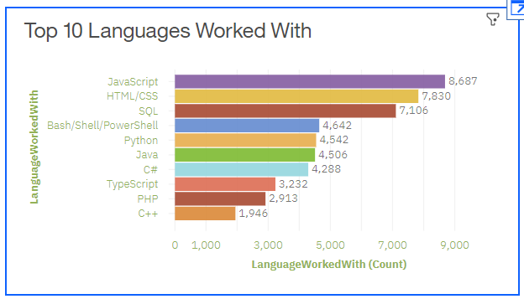
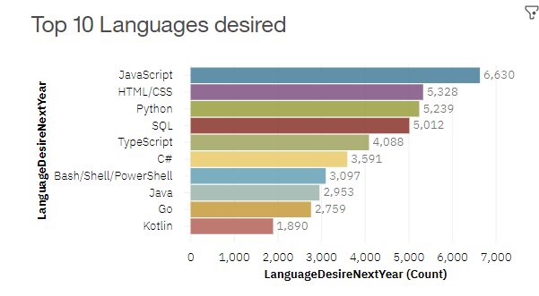
PROGRAMMING LANGUAGE TRENDS
Current Year
Next Year

Slide 9
PROGRAMMING LANGUAGE TRENDS - FINDINGS & IMPLICATIONS
Findings:
JavaScript and HTML Dominance: JavaScript and HTML are predicted to remain dominant programming languages in the future. Their continued popularity is indicative of their versatility and widespread use in web development.
Rise of Python, Typescript, and C#: Python, Typescript, and C# are on the rise, surpassing languages like Java, Bash, and PHP. This shift suggests a growing preference for languages that offer strong typing, modern features, and diverse application possibilities.
Diverse Language Landscape: The presence of multiple programming languages indicates a diverse tech ecosystem, allowing developers to choose languages that best suit their project requirements.
Implications:
Full-Stack Development: The prevalence of JavaScript and HTML implies that full-stack developers proficient in these languages will continue to be in high demand. Organizations should invest in training and hiring talent with expertise in these languages.

Slide 10
2. Versatility Matters: The rise of Python, Typescript, and C# highlights the importance of versatility in programming languages. Developers skilled in these languages can adapt to a wide range of projects, potentially making them more valuable in the job market.
3. Innovation and Competition: The diversity of programming languages indicates a competitive landscape. Developers and organizations should stay updated with language trends to remain competitive and innovative in the tech industry.
4. Specialization Opportunities: As different languages gain prominence for specific use cases, there are opportunities for developers to specialize in niche areas. For example, Python's popularity in data science and machine learning creates a specialized career path.
5. Educational Focus: Educational institutions and online learning platforms should align their curricula with emerging language trends. Preparing students with skills in languages like Typescript and C# can enhance their employability.
6. Cross-Language Integration: Organizations should consider how to facilitate integration between various languages in their tech stacks. This can optimize development processes and make the most of each language's strengths.

Slide 11
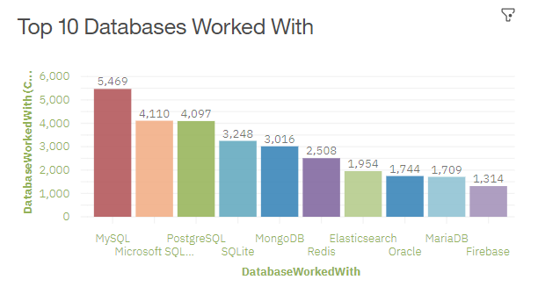
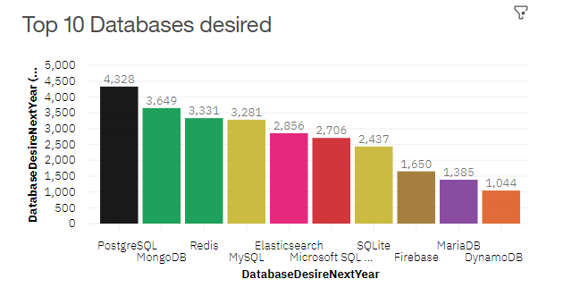
DATABASE TRENDS
Current Year
Next Year

Slide 12
DATABASE TRENDS - FINDINGS & IMPLICATIONS
Findings:
PostGRE-SQL, MongoDB, and Redis Leading: PostGRE-SQL, MongoDB, and Redis are projected to be the top three preferred databases in the future. These databases offer diverse capabilities, from traditional relational databases to NoSQL and caching solutions.
MongoDB's Versatility: MongoDB maintains its popularity not only as a database but also as a favorite among major programming languages and web frameworks. This indicates its adaptability to various development scenarios.
SQL's Resilience: SQL databases, while facing competition from NoSQL options, remain highly favored for platforms and web frameworks. This resilience suggests that SQL continues to excel in structured data and complex querying.
Implications:
Diverse Data Storage Needs: Organizations should be prepared to manage diverse data storage needs, ranging from structured to unstructured data. Employing a mix of databases like PostGRE-SQL, MongoDB, and Redis can be advantageous.

Slide 13
2. Database Integration: Developers and database administrators should focus on integrating different types of databases effectively within a tech stack. Hybrid approaches that combine the strengths of both SQL and NoSQL can yield powerful solutions.
3. Data Security and Compliance: As data storage becomes more diverse, ensuring data security and compliance remains paramount. Organizations must implement robust security measures and adhere to relevant data protection regulations.
4. Scalability Considerations: NoSQL databases like MongoDB are known for their scalability. Businesses with rapidly growing data volumes should explore these options to meet their scalability requirements.
5. Skills Development: Database professionals should consider expanding their skill set to include both SQL and NoSQL databases. Being proficient in a variety of database technologies can enhance career prospects.
6. Data Modeling Challenges: With the coexistence of different database types, data modeling becomes a critical consideration. Developers must carefully design data models that suit the database type and the application's needs.
7. Innovation and Experimentation: Organizations should encourage innovation and experimentation with database technologies. Emerging databases and data storage solutions may offer advantages in specific use cases.

Slide 14

DASHBOARD
<The permanent link of the read-only view of the Cognos dashboard goes here.>

Slide 15
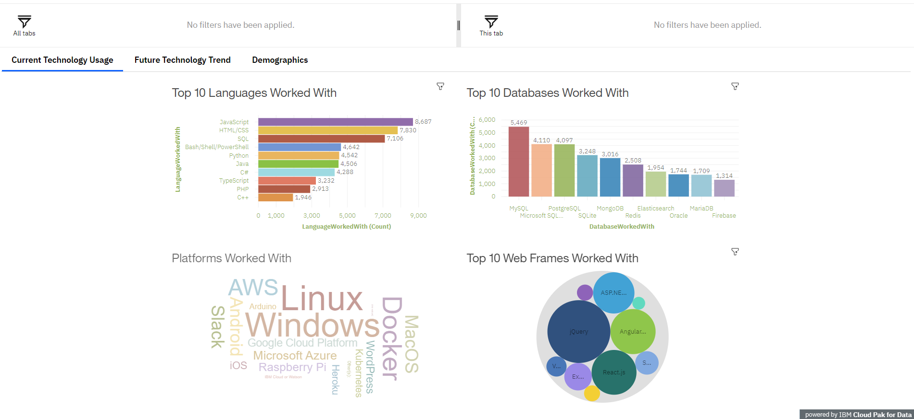
DASHBOARD TAB 1

Slide 16
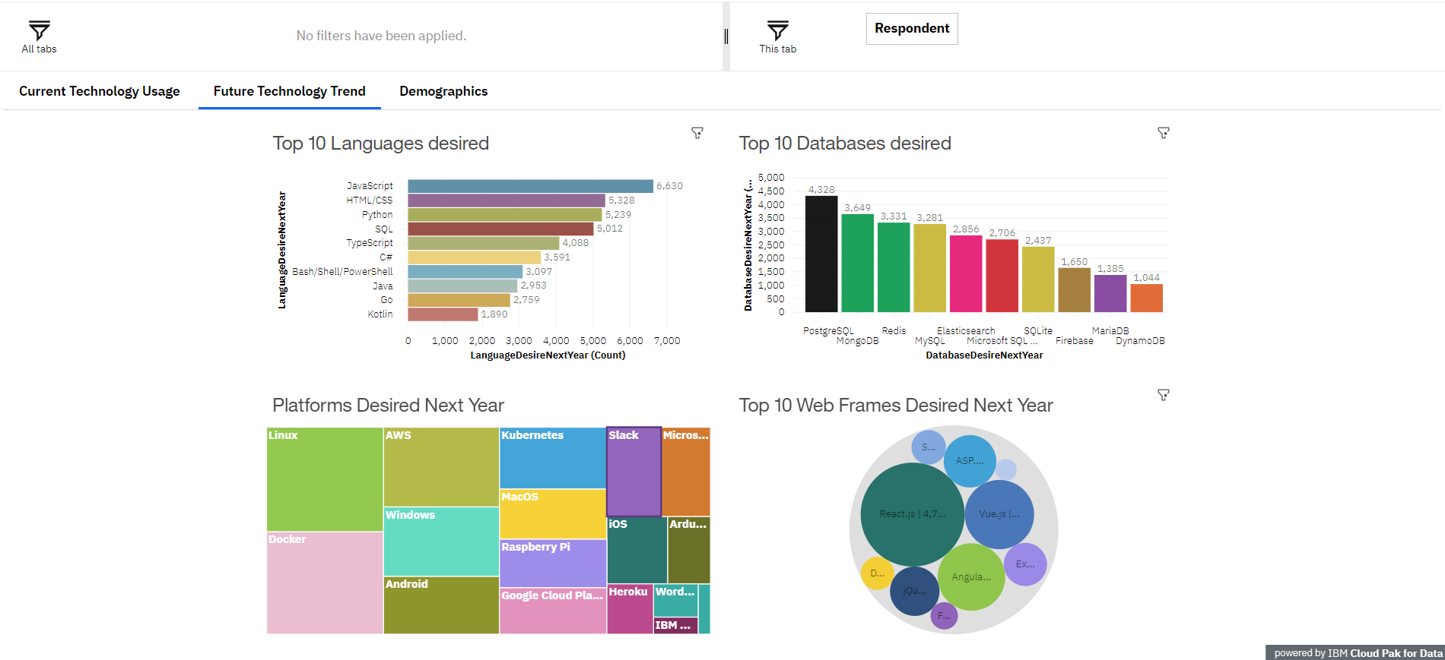
DASHBOARD TAB 2
Screenshot of dashboard tab 2 goes here

Slide 17
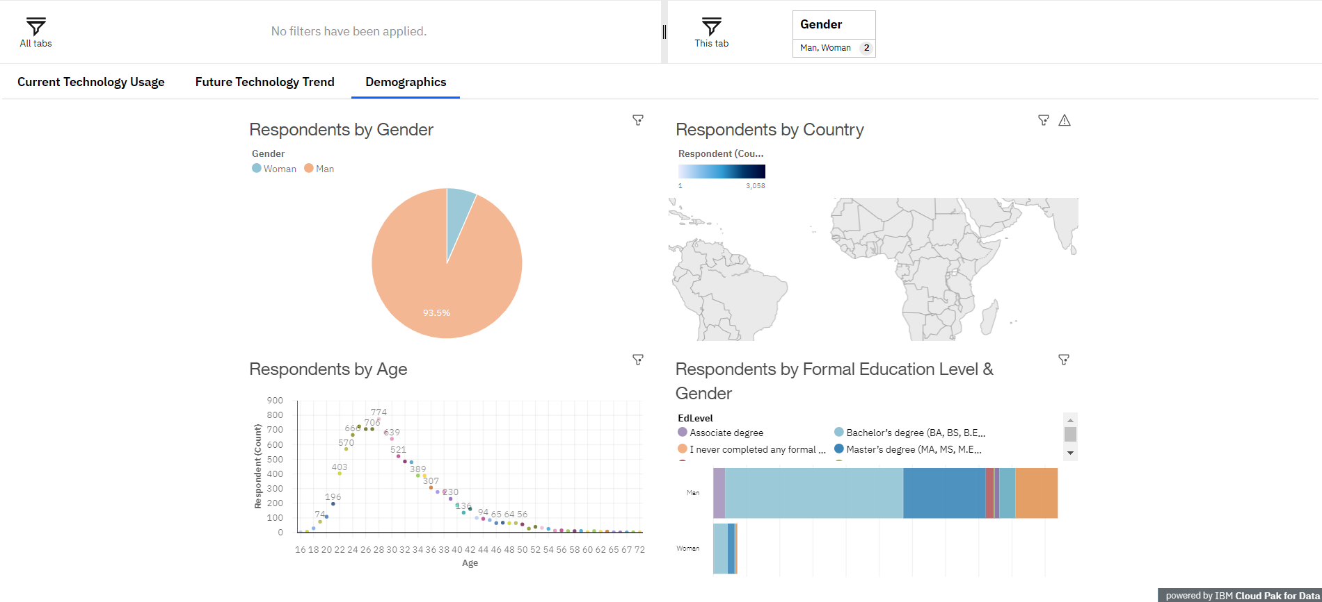
DASHBOARD TAB 3

Slide 18
DISCUSSION
Q) The Tech landscape favors certain languages, databases, platforms, and frameworks, necessitating skill development and adaptation. What's your views on this?
Q) Does Demographics, including age, location, and gender, play a role in shaping preferences and strategies?

Slide 19
OVERALL FINDINGS & IMPLICATIONS
Findings:
Programming Languages:
JavaScript and HTML remain dominant, while Python, Typescript, and C# are gaining ground.
Databases:
PostGRE-SQL, MongoDB, and Redis are emerging as top choices, while SQL databases remain robust.
Platforms:
A shift to Linux and Docker is expected, reflecting adaptability and containerization trends.
Web Frameworks:
React.js and Vue.js are on the rise as preferred web frameworks.
Demographics:
The majority are male (93.5%), aged 23 to 31, with a strong US presence and higher education.

Slide 20
Implications:
Skills and Development:
Focus on JavaScript and HTML expertise, with upskilling in Python, Typescript, and C#.
Data Diversity:
Prepare for diverse data needs with a mix of SQL and NoSQL databases.
Platform Adaptation:
Embrace Linux and Docker for future tech environments.
Web Framework Mastery:
Invest in React.js and Vue.js proficiency for web development.
Demographic Alignment:
Tailor products, services, and education to match the age and location demographics.
Global Considerations:
Recognize the significance of the US market among respondents.
Gender Diversity:
Promote gender diversity initiatives in the tech industry.

Slide 21
CONCLUSION
In conclusion,
JavaScript and HTML maintain their dominance in the programming landscape
Both come with notable shifts in preferences for databases, platforms, and programming languages expected in the future.
Respondents' demographics reveal a male-dominated, predominantly young, and highly educated cohort, primarily concentrated in the United States.
These insights can inform decisions in technology development, education, and industry trends.

Slide 22
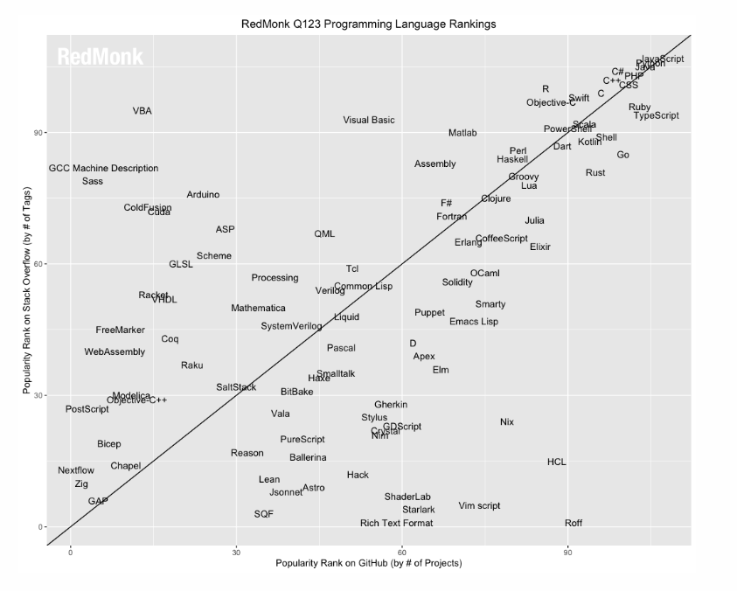
APPENDIX
First Quarter Language Rankings, 2023:
JavaScript, Python, and Java continue to dominate the top 3 positions.
There is little movement in the rankings, indicating a static language landscape.
LLM-based tooling has the potential to impact language movement, but there is no evidence of it yet.
Language rankings are based on GitHub and Stack Overflow data.
The rankings aim to reflect both code and discussion traction.
The rankings are not a statistically valid representation of current usage.

Slide 23
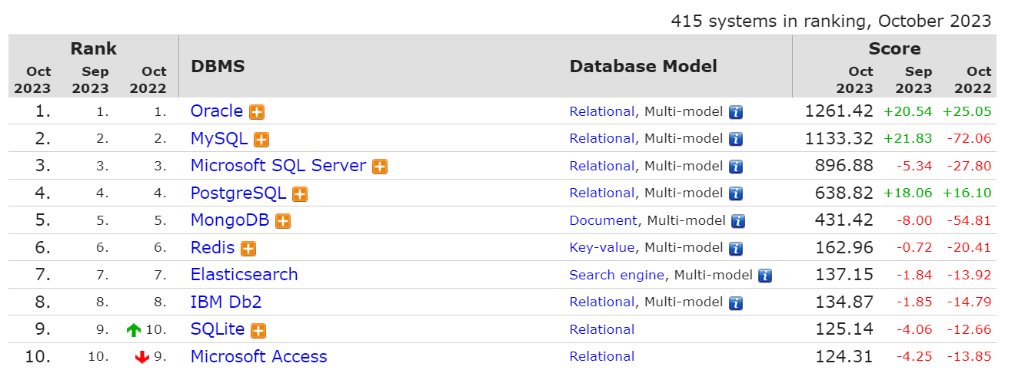
DB-Engines Ranking | db-engines.com
The DB-Engines Ranking ranks database management systems according to their popularity. The ranking is updated monthly.

Slide 24
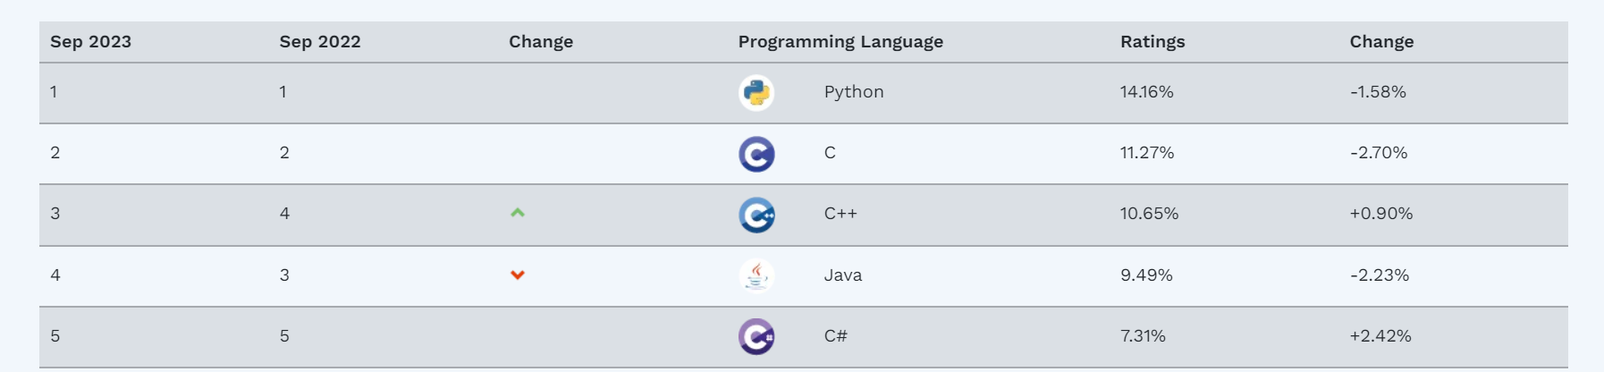
TIOBE Index:
The TIOBE Index measures the popularity of programming languages.
It is based on skilled engineers, courses, and search engine rankings.
It does not determine the best programming language or most lines of code.
The index helps programmers stay up to date and make strategic decisions.

Slide 25
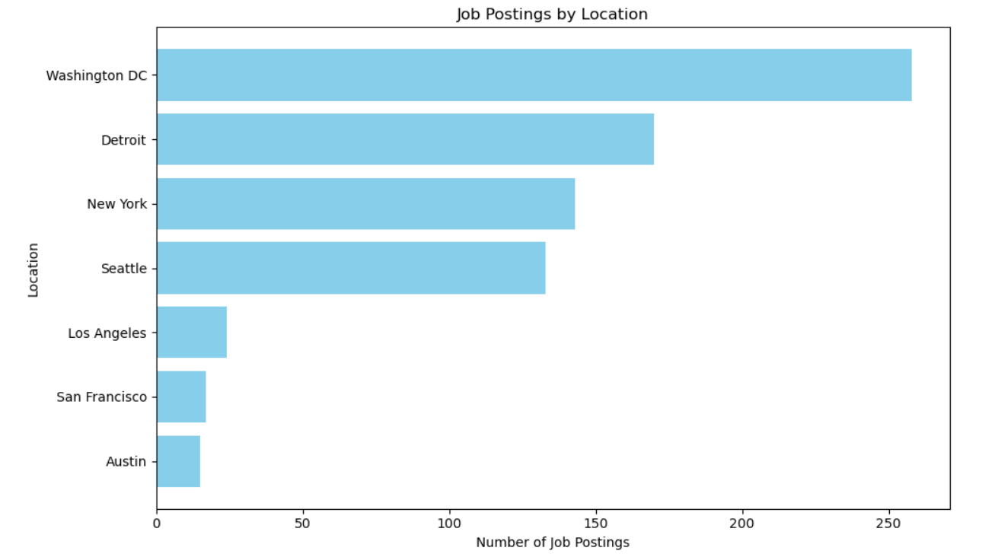
JOB POSTINGS
In Module 1 you have collected the job posting data using Job API in a file named “job-postings.xlsx”. Present that data using a bar chart here. Order the bar chart in the descending order of the number of job postings.

Slide 26
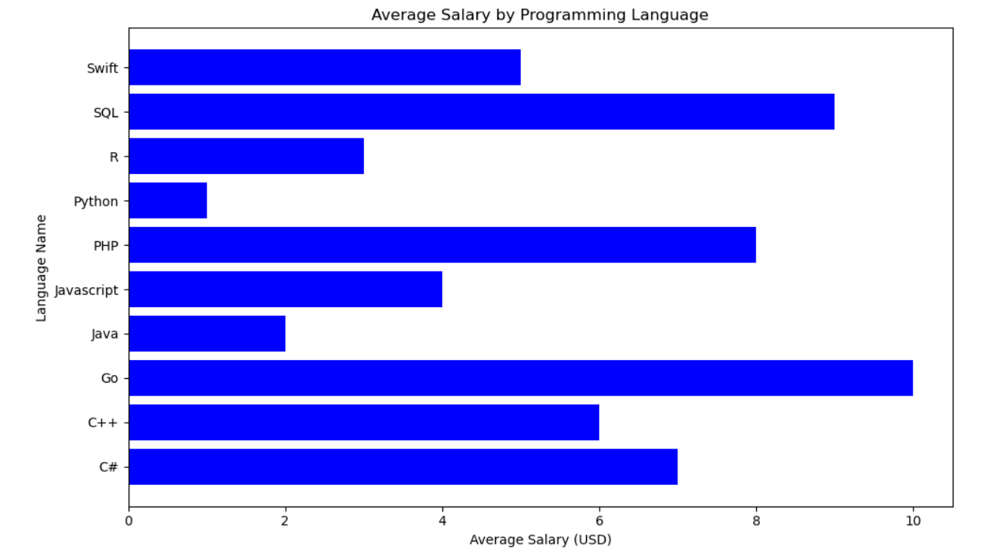
POPULAR LANGUAGES
In Module 1 you have collected the job postings data using web scraping in a file named “popular-languages.csv”. Present that data using a bar chart here. Order the bar chart in the descending order of salary.

